Slide 1
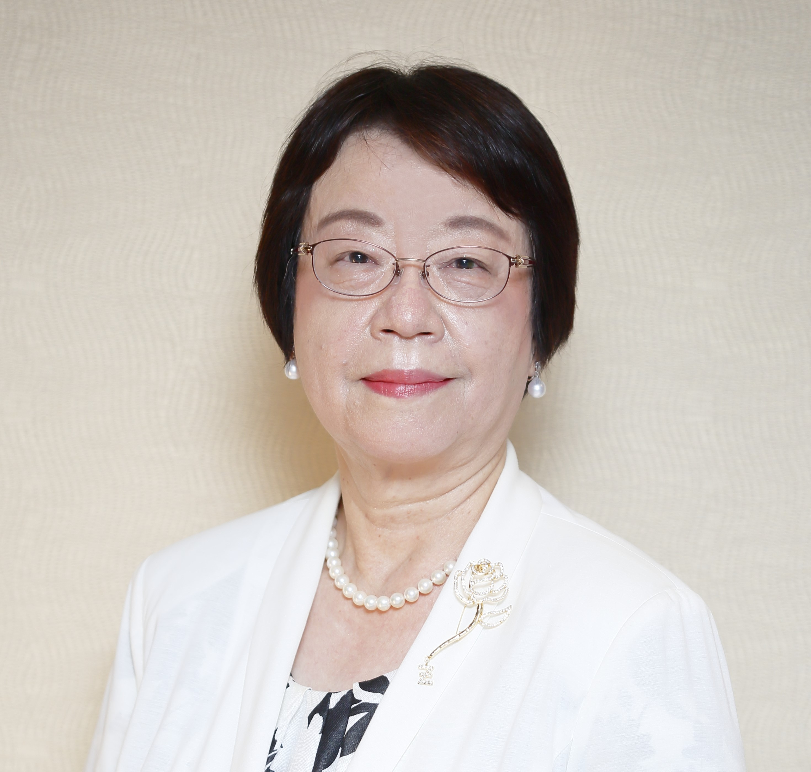
Membership Update＆Key Initiatives
Wakiko Yazaki
Lieutenant Governor
Membership Committee Chair, District 26
Zonta Club of Tokyo Ⅱ

Slide 2
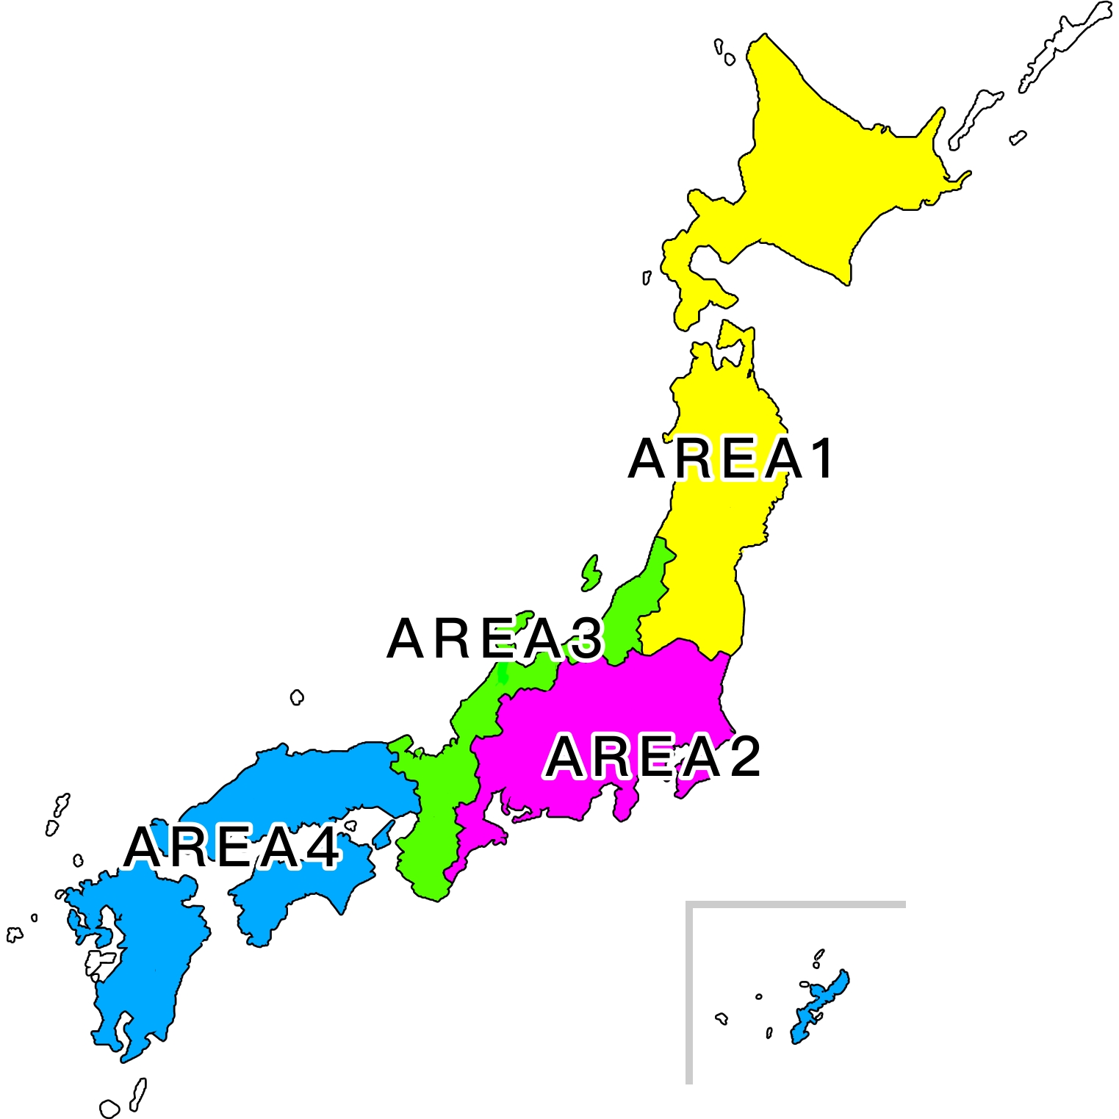
Membership Overview
As of February 28, 2025
Area | Members | Young Professionals | Male Members | Honorary Mebers
１ | 101 | １ | ６ | １
２ | 212 | ０ | ９ | 0
３ | 240 | 6 | 8 | 0
４ | 188 | 6 | 15 | 2
Total | 741 | 13（２％） | 38（５％） | ３
Z Club | 4 clubs | 52 members
Golden Z Club | 11 clubs | 178 members
Designed by Mariko Nakahara (Gunma ZC)

Slide 3
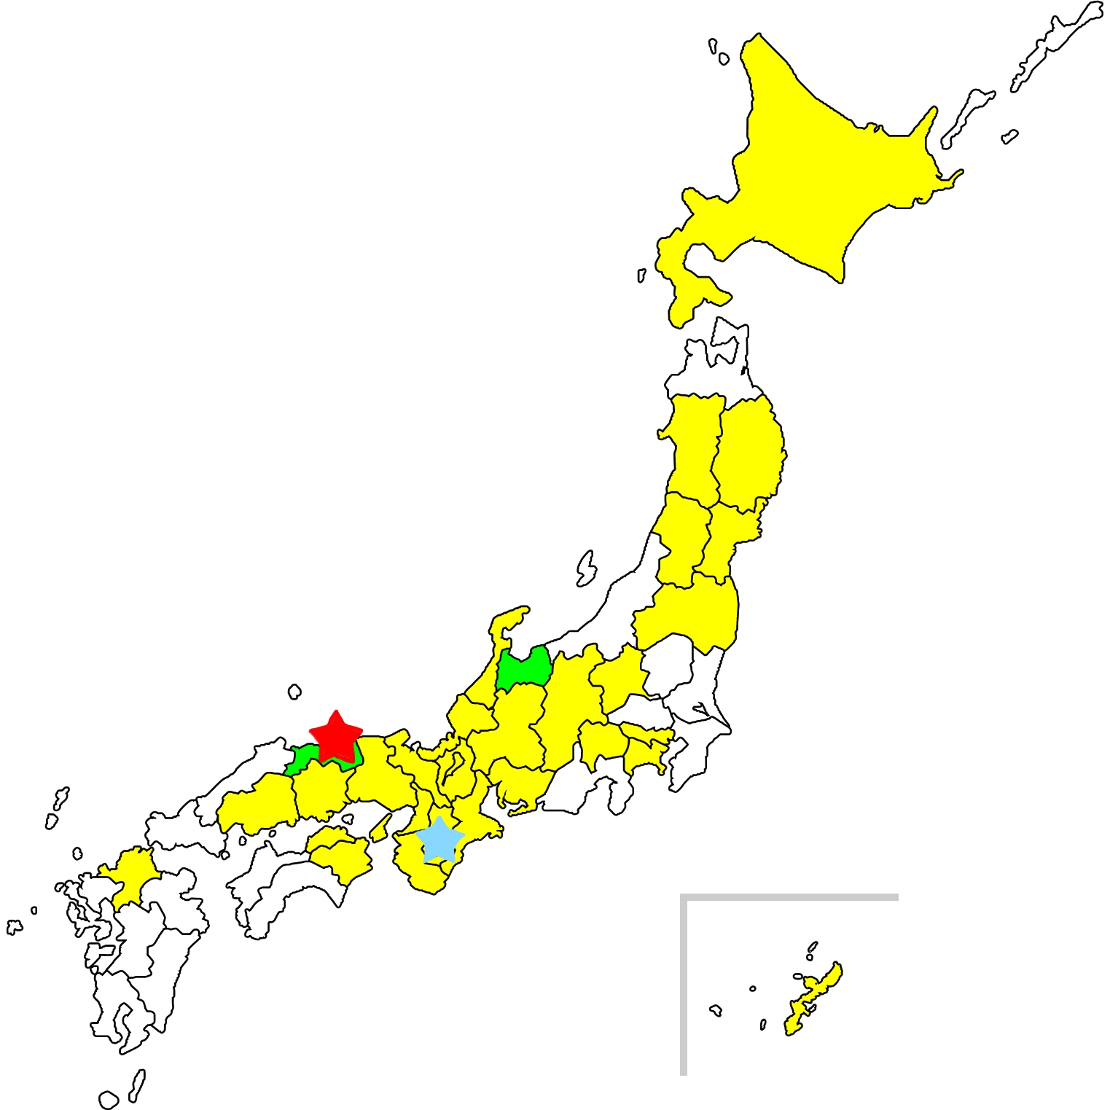
Geographic Expansion
Sea of Japan
Pacific Ocean
Designed by Mariko Nakahara (Gunma ZC）

Slide 4
1. Membership Growth Logo
“Let’s aim for 1,000 Zontians again!”
Designed by Kousuke Manabe ( Kitakyushu ZC)

Slide 5
2. Club Membership Chairs Meeting
🔶First Zoom meeting held in January
🔶41 participants from 35 clubs
🔶PPT materials from Deb Lal, International Membership
Chair: Discussions on why members stay or leave
🔶Reaffirmed the meaning of Zonta Spirit
🔶Small group discussions encouraged knowledge-sharing
🔶Strong desire to learn from one another and find new strategies
🔶Goal: Continue meetings to strengthen membership

Slide 6
3. Membership Survey
Survey response rate: 43%
🌍 72% of members are over 65 years
old – a global challenge
🎯 Engaging younger generations by:
＊ Stronger ties with GZ Clubs
＊More effective social media use
＊ Flexible participation options
💛 Senior members’ contributions are
invaluable to D26

Slide 7
Male Membership – Impact & Opportunities
Why They Join:
＊Invited through personal connections
＊Appreciate the warm atmosphere, meaningful activities, and skill-building
Impact:
＊Greater diversity in activities
＊Broader networks and discussions
＊Expanded opportunities for Zonta
Challenges:
＊Their full potential is not yet fully realized
Solutions:
＊Define clear roles and utilize unique skills
＊Organize networking events for male members
＊Develop inclusive projects for all genders

Slide 8
Young Members – Recruitment & Retention
3 Key Focus Areas: 1️⃣ Recruitment
＊Personal invitations from friends & family
＊Stronger engagement with Golden Z Clubs
2️⃣Engagement
＊Networking, career development & skill-building
＊Leadership roles for young members
＊Sharing success stories to inspire participation
3️⃣Affordability
＊Flexible membership fees
＊More cost-effective events

Slide 9
Challenges Identified
Lack of digital literacy among members
Heavy burden on officers and members
High membership fees and financial constraints
Low public awareness of Zonta
Limited diversity in club demographics
Club atmosphere and engagement issues

Slide 10
Key Strategies for Growth
Promote digitalization and IT literacy
Reduce workload for officers and members
Review and adjust membership fees
Enhance Zonta’s public visibility
Implement strategic recruitment plans
Improve club appeal and engagement
Expand and diversify membership demographics

Slide 11
Member Satisfaction
🌟90% of our members are satisfied and
proud to be Zontians
🌟They value friendships, learning
opportunities, and positive social impact
🌟The result reaffirms the strength of our
mission and community

Slide 12
ありがとうございます！
多謝！ Kiitos paljon! 谢谢! மிக்க நன்றி
Maraming salamat po! 감사합니다!
Thank you very much!
Grazie mille! Их баярлалаа! Danke schön!
ขอบคุณมากค่ะ Terima kasih banyak!

